Slide 1
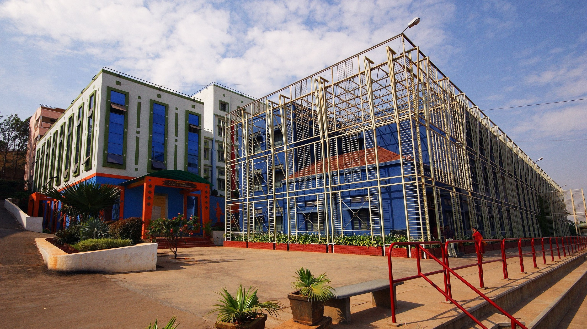




Sri Raghavendra Educational Institutions Society (R)
Sri Krishna Institute of Technology
(Approved by AICTE, Accredited by NAAC, Affiliated to VTU, Karnataka)
Department of Computer Science and Engineering​
Mini project presentation(Code Number)​
Title: Intelligent Traffic Management​
Presented By: Under the Guidance of: ​
Ranjitha.R 1KT22CS091 Supriya​ Dongare
Suma.H 1KT22CS112​
Divya Shree.D K 1KT23CS400​
Namitha H U 1KT23CS403​
www.skit.org.in

Slide 2




Sri Krishna Institute of Technology
(Approved by AICTE, Accredited by NAAC, Affiliated to VTU, Karnataka)
CONTENTS:
Introduction
Problem Statement
Objectives
Literature Review
Methodology
Reference
/skit.org.in

Slide 3
INTRODUCTION
Sri Krishna Institute of Technology
(Approved by AICTE, Accredited by NAAC, Affiliated to VTU, Karnataka)
♦ With the rapid growth of urbanization and vehicle traffic, the need for effective traffic management systems has become increasingly critical. Urban areas are witnessing significant challenges in managing traffic flow, leading to congestion, delays, and increased pollution.
♦ This project focuses on integrating CNNs with ITAS to design a system capable of detecting and tracking vehicles in real time, thereby enabling dynamic traffic control
♦ By utilizing advanced object detection and tracking techniques, the proposed system aims to reduce congestion, improve traffic flow, and ultimately enhance the safety and efficiency of urban transport networks
/skit.org.in

Slide 4
PROBLEM STATEMENT
Sri Krishna Institute of Technology
(Approved by AICTE, Accredited by NAAC, Affiliated to VTU, Karnataka)
The problem statement is “Current traffic management systems lack the ability to dynamically adjust traffic signals, optimize flow, and respond to real-time conditions, leading to inefficiencies. These systems often do not account for variations in traffic density, rush hours, accidents, or special events that can cause sudden changes in traffic patterns. ”
/skit.org.in

Slide 5
OBJECTIVES
Sri Krishna Institute of Technology
(Approved by AICTE, Accredited by NAAC, Affiliated to VTU, Karnataka)
1. To study various available methods for traffic flow prediction and real-time monitoring.
2. To explore deep learning networks, such as YOLOv3, and Deep SORT, for traffic analysis and management.
3. To develop a high-level system design for adaptive traffic signal control and congestion mitigation.
4. To design and implement a detailed system for secure data collection and management using AI and blockchain technologies.
5. To test and evaluate the traffic management system under various conditions using different machine learning and deep learning algorithms.
/skit.org.in

Slide 6
LITERATURE SURVEY
Sri Krishna Institute of Technology
(Approved by AICTE, Accredited by NAAC, Affiliated to VTU, Karnataka)
Papers | Models | Methodology | Limitations and Drawbacks
Intelligent Traffic Analysis System Using Deep Learning | YOLOV3,Mobilenet, CNN | Data Collection and Preprocessing, Model Training and TransferLearning, Real-time Traffic Analysis and Control | Data Quality and Dependency on Training, Cost of Implementation and Maintenance
Optimizing Traffic Flow with Fuzzy Logic and Machine Learning | Fuzzy logic controllers(FLC’s) | Real-Time Data Collection and Preprocessing, Fuzzy Logic and Machine Learning Integration, Simulation and Performance Evaluation | Dependence on Real-Time Data Quality , Computational Complexity
/skit.org.in

Slide 7
LITERATURE SURVEY
Sri Krishna Institute of Technology
(Approved by AICTE, Accredited by NAAC, Affiliated to VTU, Karnataka)
Papers | Models | Methodology | Limitations and Drawbacks
Density based smart traffic control system using canny edge detection | Image Preprocessing Using Canny Edge Detection , Mask R-CNN OPEN CV | Real-Time Image Collection and Processing, Edge Identification and Vehicle Density Calculation, Dynamic Signal Adjustment | Dependency on Image Quality and Environmental Conditions, Vulnerability to System Failures
AI-Powered Solutions for Traffic Management Reducing Congestion and Emissions | Deep Reinforcement Learning ,Convolutional Neural Network | Real-Time Traffic Data Collection, AI and Machine Learning Optimization, Case Study Analysis | Data Dependency and Accuracy, Data Privacy and Security Concerns
/skit.org.in

Slide 8
METHODOLOGY
Sri Krishna Institute of Technology
(Approved by AICTE, Accredited by NAAC, Affiliated to VTU, Karnataka)
Frame preprocessing
Object detection using YOLOv5 and CNN
Input video/Image stream
Result outcomes
Trained model/Testing data set
/skit.org.in

Slide 9
^{REFERENCES}
Sri Krishna Institute of Technology
(Approved by AICTE, Accredited by NAAC, Affiliated to VTU, Karnataka)
♦ Ayesha Asif Pailwan, Dr.Mr.B.D.Jitkar."Intelligent Traffic Analysis System Using Deep Learning."
♦ Abdullahi Ahmed Bashi,Abdurazzg Ali A Aburas."Optimizing Traffic Flow with Fuzzy Logic and Machine Learning ."
♦ Harsha P,Rahatekar R Rama,Vaishnavi T Reddy, S sreeya."Density based smart traffic control system using canny edge detection"
♦ Mithu Karmakar,Pravakar Debnath,M D Azam Khan ."AI-Powered Solutions for Traffic Management Reducing Congestion and Emissions ."
/skit.org.in

Slide 10
THANK YOU
Sri Krishna Institute of Technology
(Approved by AICTE, Accredited by NAAC, Affiliated to VTU, Karnataka)
/skit.org.in

